Slide 1
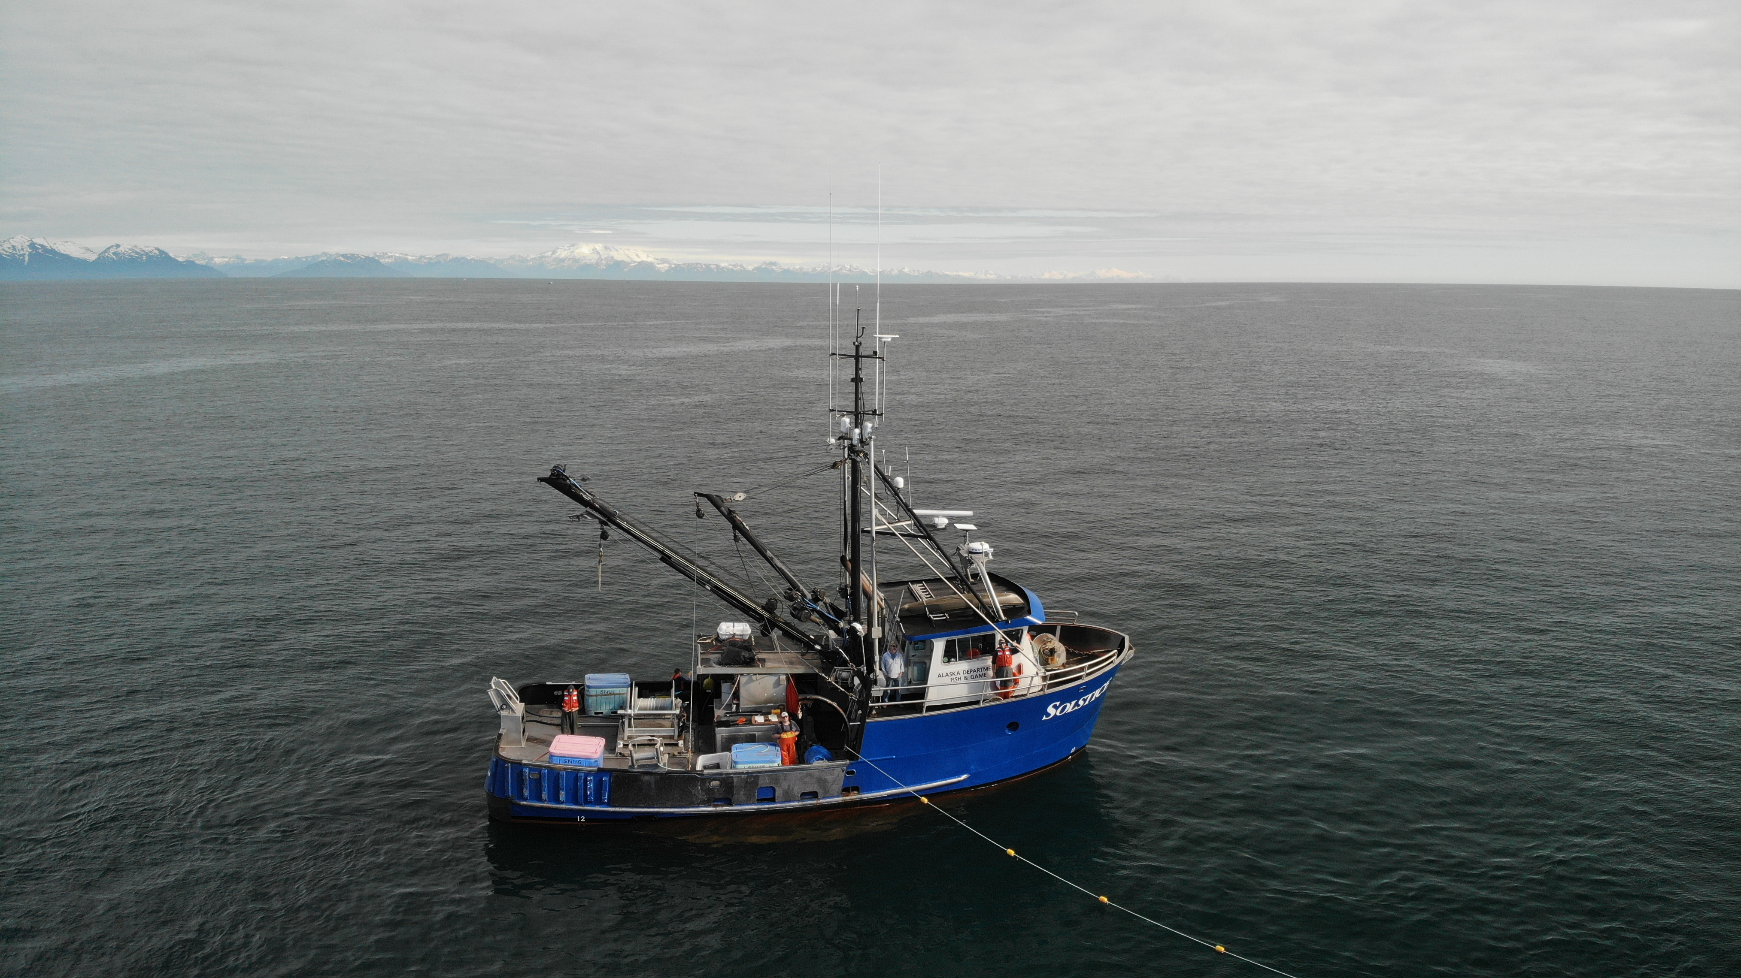


Upper Cook Inlet Total Run Report
Alaska Department of Fish and Game

Slide 2
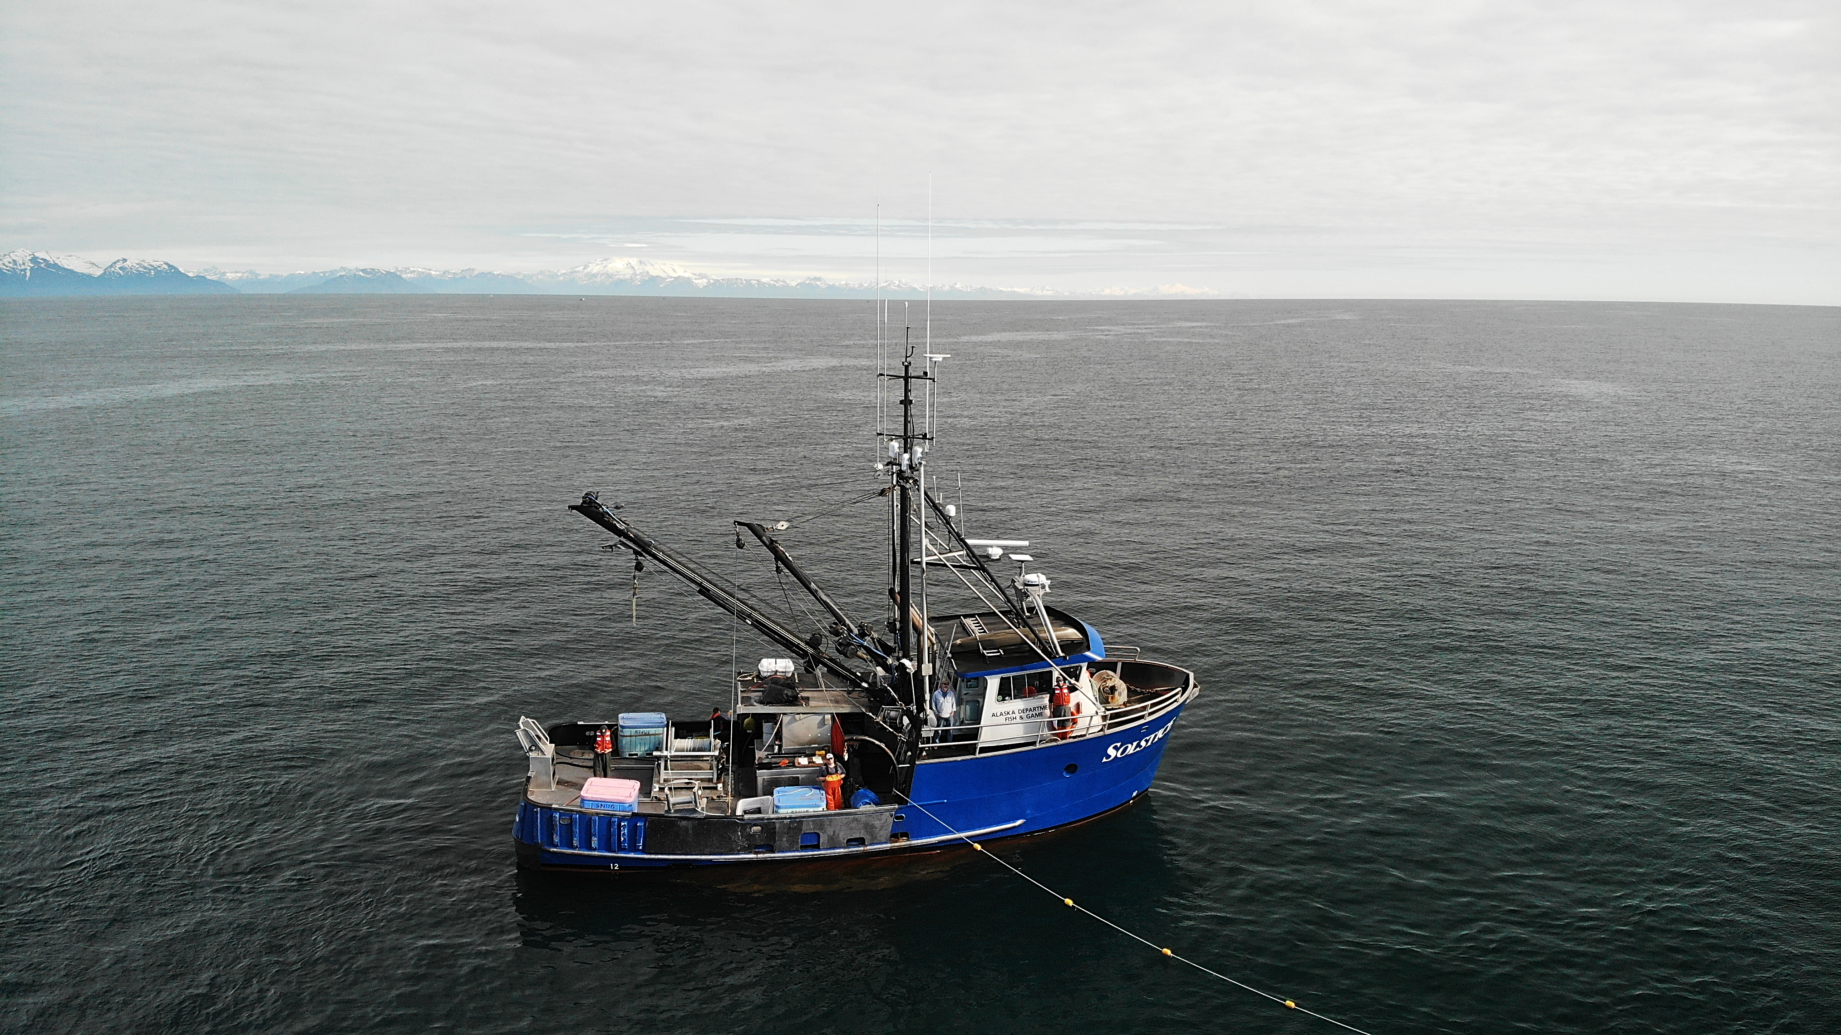
2024 Upper Cook Inlet Sockeye Salmon
Inseason Total Run Report
Alaska Department of Fish and Game

